Slide 1






Education
Service Agencies
Governance, funding, services, and opportunities for North Carolina
Joan H. Wade, EdD | Executive Director, AESA
North Carolina Blue Ribbon Commission on Public Education | September 28, 2026

Slide 2











Today’s Discussion
01
How regional ESAs serve school districts
Building Regional Capacity to Better Serve Schools
02
Governance and funding choices across states
03
Examples of shared services and potential cost savings
Strengthening Schools
Through Scale
04
Options for strengthening North Carolina’s regional capacity

Slide 3


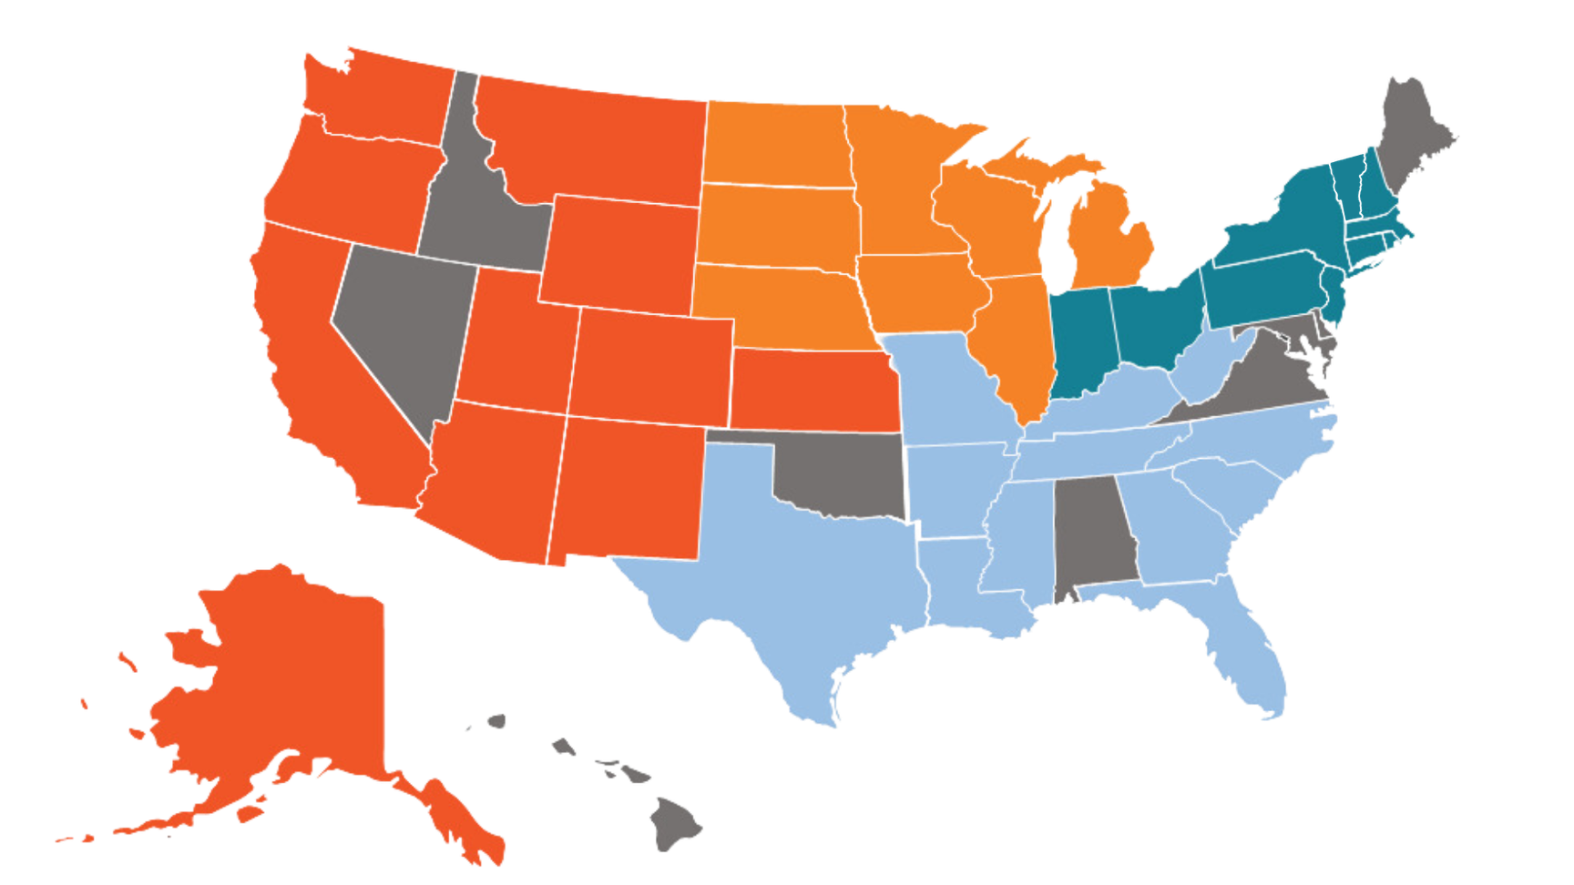
What is an ESA?
National reach refers to AESA membership, not every ESA operating in the United States.
  A regional organization that serves multiple school districts
  The alliances provide professional learning and other support to member districts
  Their structures and service menus vary by region
  The policy question: What additional statewide capacity should the existing network provide?

Slide 4


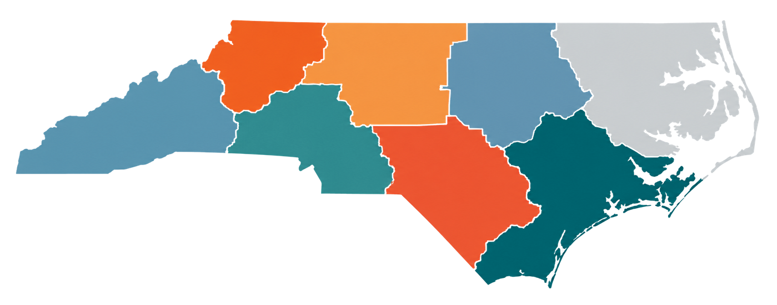

North Carolina’s Starting Point
  North Carolina already has regional education service alliances (RESAs)
  The alliances provide professional learning and other support to member districts
  Their structures and service menus vary by region
  The policy question: What additional statewide capacity should the existing network provide?

Slide 5









Governance Structure of ESAs
STATE EDUCATION AGENCIES
Oversight and support
  District leaders or school board members can govern regional agencies
  Other models use appointed or elected boards
ESA
  State law can set duties while local boards guide service priorities
GOVERNING BOARD
  Clear oversight should include transparent budgets, service agreements, and results
LOCAL SCHOOL DISTRICTS
COMMUNITIES
Partnership and service delivery
Local voices and stakeholder input

Slide 6











STATE APPROPRIATIONS AND GRANTS
Funding Sources and Mechanisms
Core state funding and grant programs
that support ESA operations and initiatives
LOCAL DISTRICT CONTRIBUTIONS
Local investment from school districts
that benefit from ESA services
A sustainable mix of support
that empowers ESAs to strengthen schools and student outcomes
FEDERAL FUNDING STREAMS
Federal allocations and competitive grants that advance priority programs
FEE-FOR-SERVICE REVENUES
Revenues generated through specialized services provided to districts and partners

Slide 7

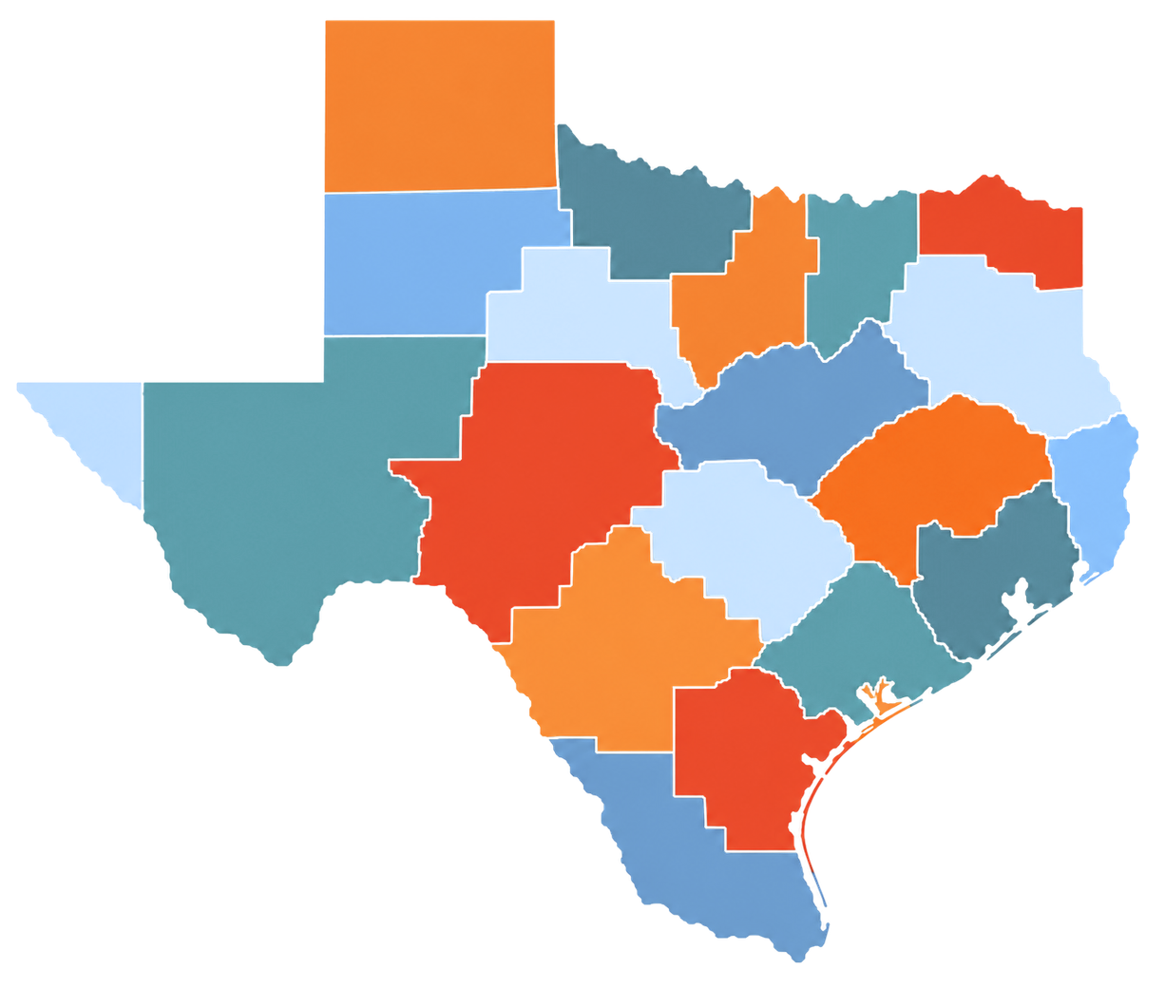
Texas: A Statewide Service System
  20 regional Education Service Centers serve districts across Texas
  District participation in center services is voluntary
  State and federal funds plus district contracts finance the centers
  Their state-defined mission includes more efficient district operations

Slide 8

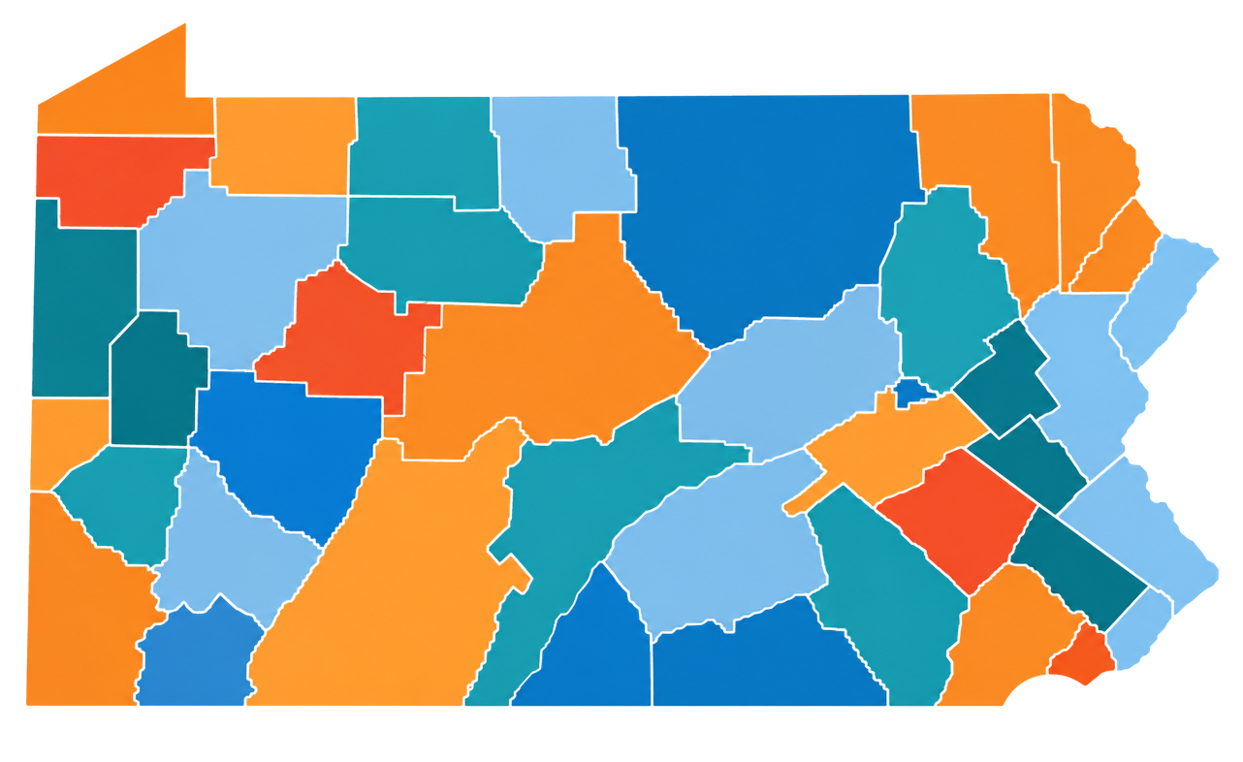
Pennsylvania:
Regional Student Services
  29 Intermediate Units provide special education, professional learning, and technical assistance
  Regional IDEA grants support services for eligible students with disabilities
  A regional provider can serve needs that are difficult to staff in each district

Slide 9
















Core Services
by ESAs
Professional development and training
Special education support
Comprehensive support to strengthen districts, empower educators, and improve student outcomes.
Technology and data services
Curriculum and instructional support
Fiscal and administrative services

Slide 10



Three Services
Specialists: Share expertise across districts; compare coverage and full cost
in Practice
These are examples of mechanisms and measures, not claimed savings for North Carolina.
Cybersecurity: Coordinate technical support and training; track uptake and risk reduction
Purchasing: Aggregate demand; compare paid prices and procurement costs

Slide 11
ESTABLISH THE BASELINE
Start with what districts currently spend and the level of service or expertise they can access.
How to Test Value
CAPTURE THE TRUE COST
Compare that baseline with the full cost of regional delivery, including administration, staffing, and travel.
Regional value isn’t just about spending less. It’s about what districts can access, accomplish, and sustain together.
LOOK BEYOND DOLLARS
Measure service quality, district participation and use, and student or operational outcomes.
SEPARATE THE VALUE
Report direct cost savings independently from gains in access, capacity, or service quality.

Slide 12


A Stronger Regional Structure Could Lower Costs and Expand Capacity
01
Pool hard-to-fill specialist positions across districts
Create capacity districts can share, not simply another layer of service.
02
Coordinate procurement and shared technology contracts
03
Provide shared training and operational support regionally
04
Provide stable regional capacity, then fund selected services by need
Empowering every student. Strengthening every community.
05
Pilot, measure costs and results, then expand based on evidence

Slide 13

Thank You!
Stronger regions. Greater capacity. Better support for schools.
920-420-8822
https://aesa.us
jwade@aesa.us

